Slide 1
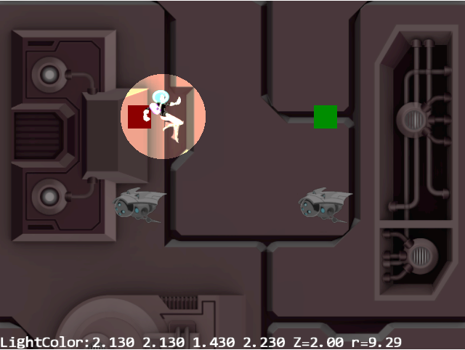
Volume of Illumination
Point Light
Z = 10
Z
Z = 0
Y
X
Illuminated Circle

Slide 2
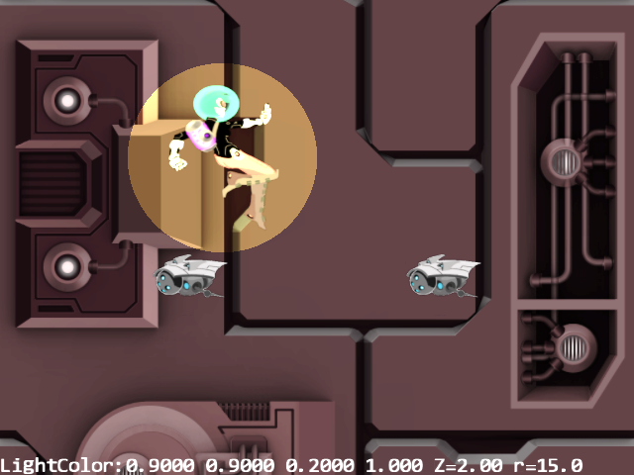
Volume of Illumination
Point Light
Z = 10
Z = 0
Z
Y
X
Illuminated Circle
Figure 8-2

Slide 3
Transform
Camera
Engine_VertexBuffer
Engine_Textures
Light
Renderable
Game Engine
SpriteAnimatedRenderable
LightRenderable
Shader
TextureShader
SpriteShader
LightShader
TextureVS
per Vertex
from
SimpleVS
aTextureCoordinate
WebGL
LightFS
lightOn
per Pixel
from SimpleFS
position
color
from TextureFS
radius
Figure 8-3

Slide 4
Transform
Light
Renderable
mLights
(array of Light)
Game Engine
LightRenderable
Shader
mShaderLights
(array of ShaderLightAtIndex)
LightShader
per Vertex
TextureVS
WebGL
LightFS
per Pixel
from SimpleFS
uLights
from TextureFS
Figure 8-5

Slide 5

$$\hat{N}$$
Surface
element
$\hat{N}$= Normal Vector
Object in 3D space
Figure 8-7

Slide 6
$$\hat{N}$$
$$\hat{L}$$
Light Source
A
$$\hat{N}$$
$$\hat{N}$$
$$\hat{L}$$
$$\hat{L}$$
C
B
Figure 8-8

Slide 7
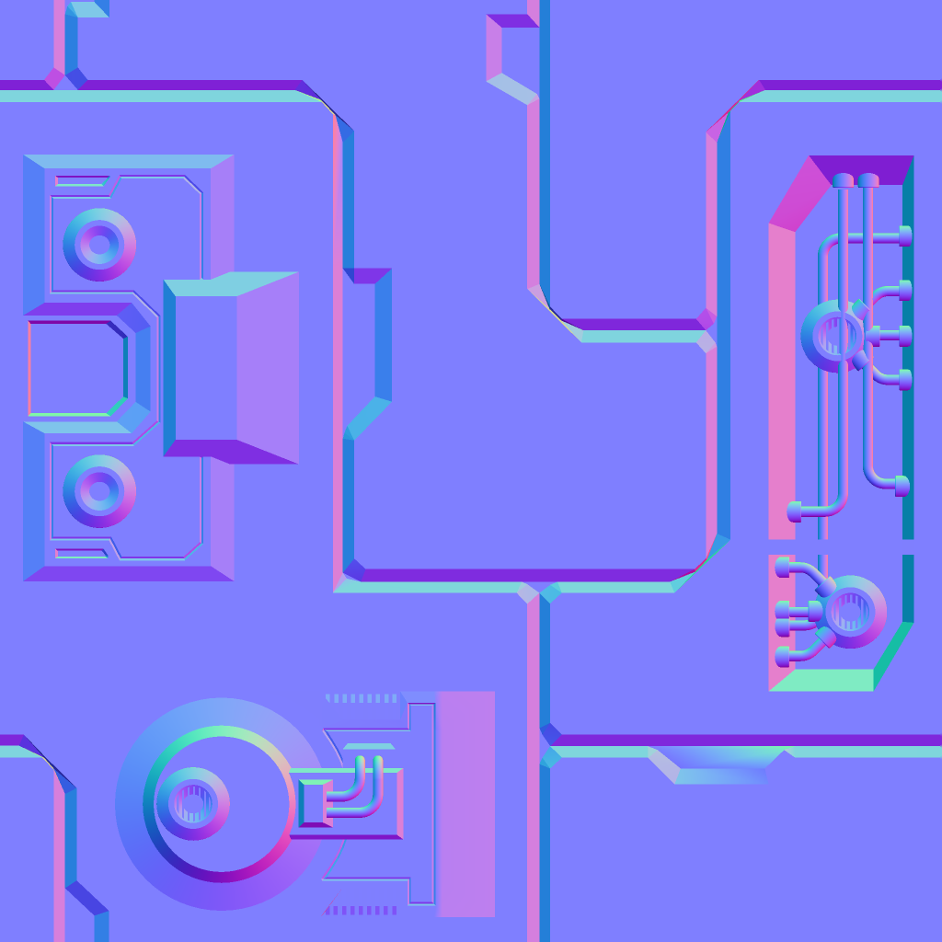
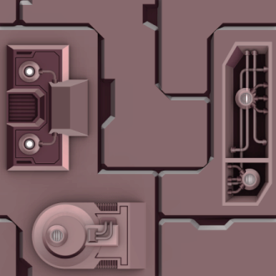

n₁
n₂
n₃
Normal texture
c₁
c₂
c₃
Color texture
eye
Figure 8-10

Slide 8
Perceived 3D contour
n₁
n₂
n₃
Normal texture
c₁
c₂
c₃
Color texture
Figure 8-11

Slide 9






$$\hat{N}$$
Light Source
eye
$$\hat{V}$$
$$\hat{L}$$
$$θ$$
$$θ$$
$\hat{N}$= Normal Vector
$\hat{V}$= View Vector
$\hat{L}$= Light Vector
Shiny Surface
Figure 8-13

Slide 10





A
$$\hat{V}$$
$$\hat{N}$$
$$\hat{R}$$
$$\hat{L}$$
B
$$α$$
$$\hat{V}$$
$$α$$
$$θ$$
$$θ$$
Specularity${∝\left(\hat{V}∙\hat{R}\right)}^{n}$
$\hat{R}$= Reflection of $\hat{L}$
n = Shininess
Figure 8-14

Slide 11



$$\hat{N}$$
$$\hat{H}=\frac{\hat{L}+\hat{V}}{2}$$
$$\hat{V}$$
$$β$$
$$\hat{L}$$
$$θ$$
$$θ$$
$\hat{H}$= Halfway Vector
Figure 8-16

Slide 12


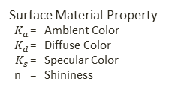


The Phong Illumination Model
$$C={K_{a}+I}_{a}C_{a}+I_{L}C_{L}K_{d}\left(\hat{N}∙\hat{L}\right)+{I_{L}C_{L}K}_{s}{\left(\hat{N}∙\hat{H}\right)}^{n}$$
Global Ambient Lighting ${ I}_{a}$ = Intensity (a float)
${ C}_{a}$= Light Color
$$\hat{V}$$
$$\hat{N}$$
$$\hat{H}$$
$$\hat{L}$$
Light Source
${ I}_{L}$ = Intensity (a float)
${ C}_{L}$= Light Color
$$θ$$
$$θ$$
Surface Material Property
$K_{a}$ = Ambient Color
$K_{d}$ = Diffuse Color
${ K}_{s}$ = Specular Color
n = Shininess
Figure 8-17

Slide 13
Transform
Light
Material
Renderable
LightRenderable
Game Engine
IllumRenderable
Shader
LightShader
(Data type: ShaderMaterial)
IllumShader
mMaterialLoader
per Vertex
TextureVS
WebGL
IllumFS
per Pixel
uMaterial
Figure 8-18

Slide 14
Point Light
Directional Light
Spot Light

Slide 15
Light position
Light direction
Outer cone angle
Inner cone angle
Figure 8-20

Slide 16

Light.Position
lgtDir
Encoded by: cosL = lgtDir dot$\hat{L}$
Encoded by: lgt.CosInner
$$\hat{L}$$
eye
Encoded by: lgt.CosOuter
$$\hat{V}$$
Position to be illuminated
Figure 8-22

Slide 17

No Hero shadow on the background
Hero shadow on minion (Shadow caster geometry)
Hero causing the shadow (Shadow caster)
Minion receiving the shadow (Shadow receiver)
Figure 8-23

Slide 18
Light source
Hero (Shadow caster)
Shadow caster geometry
Minion (Shadow receiver)
Figure 8-24

Slide 19
Region should not be drawn
Light source
Shadow caster
Shadow caster geometry
Shadow receiver
Figure 8-25

Slide 20
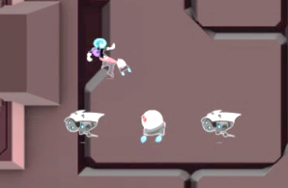
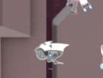
Original image
Stencil buffer
(on/off)
Results displayed in the canvas
Figure 8-26

Slide 21
Directional light
Point or spot light
Parallel projection
Projection from a point
Shadow caster
Shadow caster geometry
Shadow receiver
Figure 8-28

Slide 22




$$\hat{N}$$
Light Source
$$\hat{V}$$
$$\hat{H}$$
$\hat{N}$= Normal Vector
$$\hat{L}$$
$\hat{V}$= View Vector
$\hat{H}$= Halfway Vector
$\hat{L}$= Light Vector

Slide 23
Light source
Hero (Shadow caster)
Should not be drawn
Shadow geometry
Minion (Shadow receiver)
Background not receiving shadow

Slide 24





The Phong Illumination Model
$$I=k_{a}L_{a}+k_{d}L_{d}\left(\hat{N}∙\hat{L}\right)+k_{s}L_{s}{\left(\hat{N}∙\hat{H}\right)}^{n}$$
$$\hat{V}$$
$$\hat{N}$$
$$\hat{H}$$
$$\hat{N}∙\hat{L}$$
$$\hat{R}$$
$$\hat{L}$$
$\hat{N}$= Normal Vector
$$\hat{V}∙\hat{R}$$
$\hat{V}$= View Vector
$\hat{H}$= Halfway Vector
$\hat{L}$= Light Vector
$\hat{R}$= Reflection of $\hat{L}$

